Slide 1
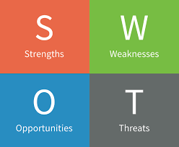
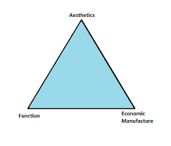
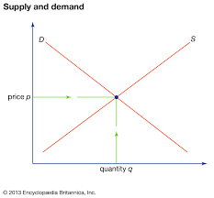
Identifying and understanding customer needs
Business Studies BTEC L3 Learning Journey
Creating informed, discerning employees, consumers and future leaders
Assessment Task Personal Swot analysis and Action Plan
SWOT analysis
Assessment Task
Job Application & interview
Review & evaluation
Job application & interview skills
Assessment Task Recruitment process
Cash and cash-flow
Breakeven analysis
Ratio analysis
Effective recruitment
Sources of business finance
Unit 8 – Recruitment & Selection
Legal & ethical considerations
Income & expenditure
Income statements, balance sheets
UNIT EXAM
Insurance
Current Accounts
Functions and role of money
YEAR
Unit 3 Personal & Business Finance
13
Financial institutions
Borrowing, saving & investing
Payment methods
Assessment Task innovation & enterprise
Product
Promotion
Extended Marketing Mix
UNIT EXAM
PESTLE analysis
SWOT analysis
5 Forces analysis
Place
Pricing strategies
Budgets & Timescales
Innovation and Enterprise
Introduction to business
Market research
Segmentation
Role of marketing
Assessment Task Market analysis
Demand Supply & price theory
Changes to aims and objectives
Unit 2 Developing a marketing campaign
Practice Assessment Task
Marketing aims and objectives
Types of market
Business aims and objectives
Assessment Task Organisation structures & Aims
SWOT analysis
Assessment Task situational analysis
PESTLE analysis
The competitive environment
Market Structures
Organisational structures
Effective communication
Assessment Task Features of businesses
YEAR
Unit 1 Investigating Business
12
Assessment Task Stakeholders & communication
Business stakeholders
Features of a business
Taxation

