Slide 1
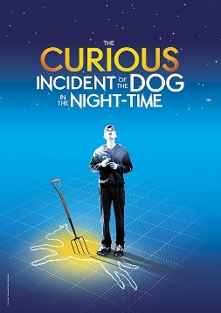
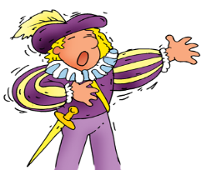
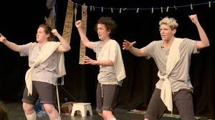
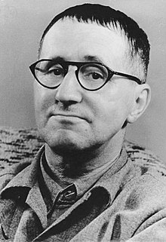
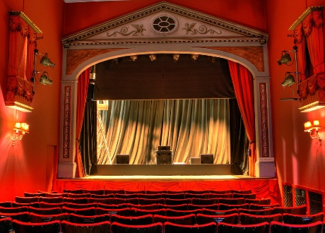
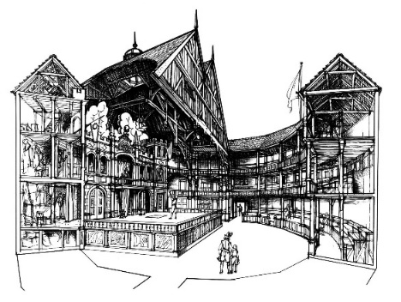
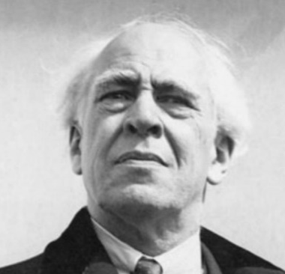
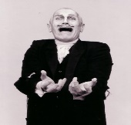
Evaluate live theatre
Component3
Chauncy Drama Learning Journey
Sixth form
college
Performing from a text
Practical performance of scripted extracts in small groups to an examiner
Component 2
Interpreting Theatre
Revise set study text practically and study a piece of live theatre to evaluate. Prepare and practice written answers for exam
Component 3
Devising project
Working as a group devising from a stimuli using the influence of a practitioner or genre
Component 1
11
Touring pantomime
Rehearsal of a short interpretation of a traditional pantomime story to be performed to local Primary schools
Scripted showcase
Practical performance of scripted extracts in small groups to an invited audience
Set text
Practical study of the set text as an actor, director and designer in preparation for the written exam
Further practitioners and devising project
Introducing more practitioners before working as a group devising from a stimuli using the influence of a practitioner or genre
Pantomime
Discovering the origins of pantomime and devising a new Christmas themed story
Devising project
Working as a group devising from a stimuli using the influence of a practitioner or genre
The Curious Incident of the Dog in the Night-Time
Explore key scenes from the play using the physical theatre methods of frantic assembly and Stanislavski’s system
T.I.E
Project based work where an educational message is presented.
10
Scripted performance
Practical performance of scripted extracts in small groups
Practitioners
Exploring the main practitioners whose work has left a legacy in Drama as well as modern theatre companies who they have inspired
History Of Theatre
Going back to the very beginning through a whistle stop tour of the key moments in theatre history
9
Year 8 options
Year 7 and 8 Drama

