Slide 1
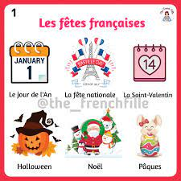
 | Learning Journey Map Key STAGE 3 FRENCH
Start GCSE
course in Year 9
Assessments every half term
Y 8 Grammar
Using 3 tenses together
(past present, future)
Giving a range of opinions
The comparative
Using negatives
Using pouvoir +infinitive
Using il faut +inf
“jouer à ” and “faire de”
Reflexive verbs
Y 8 Learning objectives
Describing an amazing holiday
Saying how you celebrate festivals
Giving opinions
Talking about TV /cinema
Talking about food and mealtimes
Describing where you live
Talking about sports and injuries
Y8 Topics
My holidays
Festivals
Leisure time
Home life
Sport
YEAR
8
Y 7 Grammar
adjectival agreement
Verbs AVOIR / AIMER / FAIRE / ÊTRE
opinions
Present Tense of regular ER verbs
Aimer + definite article /infinitive
Possessive adjectives
Introduction to Future Tense
Y7 Topics
Me
My school
My free time
My family
My town
Introduction to language
Greetings
Introducing yourself
Numbers and alphabet
Essential phonics
Physical and character descriptions
Gender and plurality
Talking about birthdays
Talking about siblings and pets
YEAR
7
SKILLS TAUGHT ACROSS ___ FRENCH___
READING COMPREHENSION
LISTENING COMPREHENSION
GRAMMAR
SPEAKING AND COMMUNICATION
WRITTEN EXPRESSION

