Slide 1
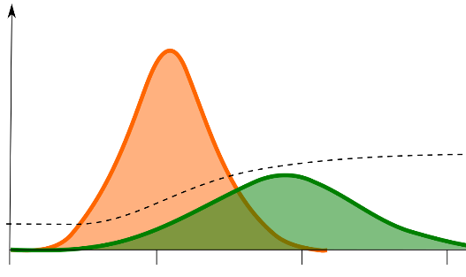
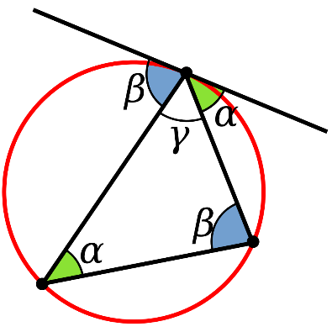
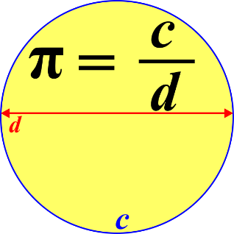
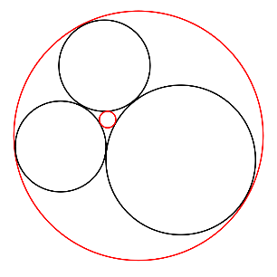
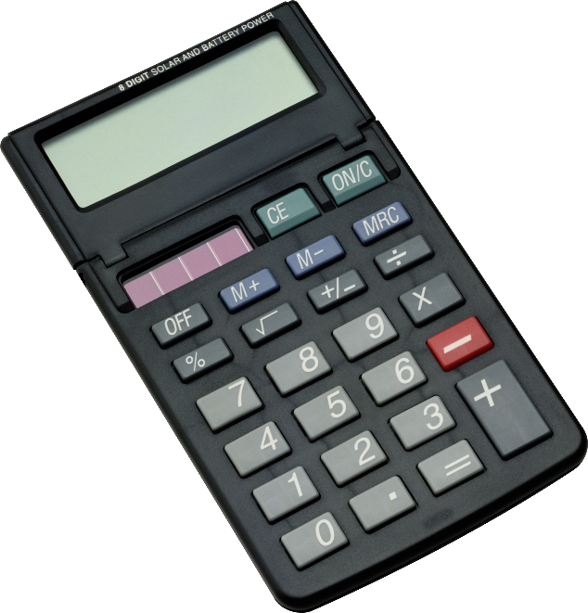
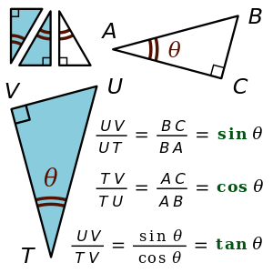
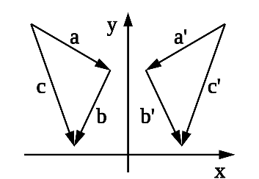
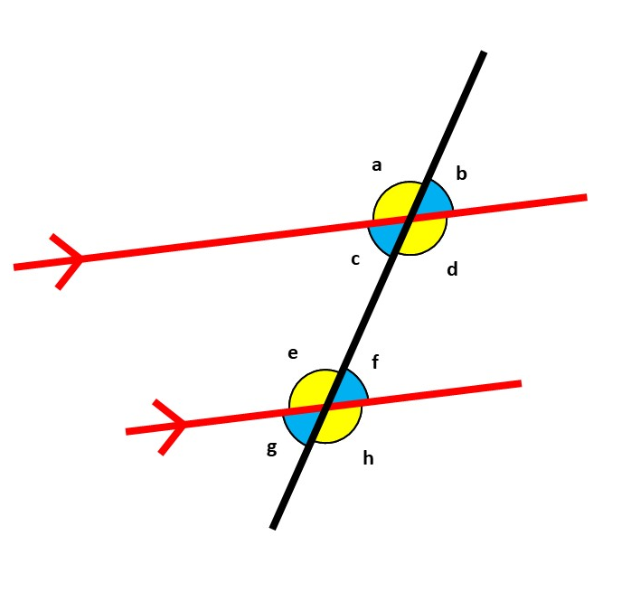
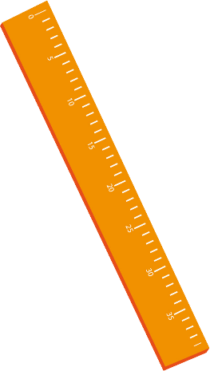
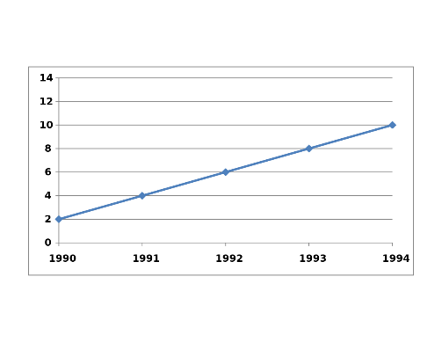
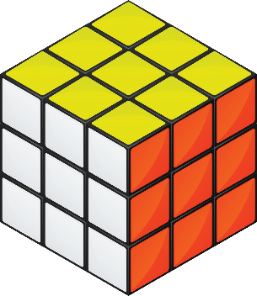
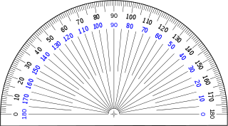
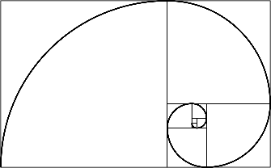
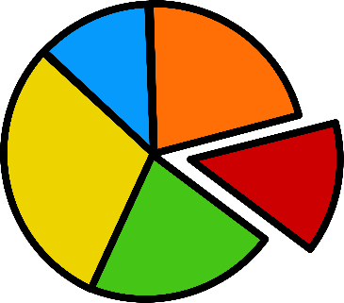
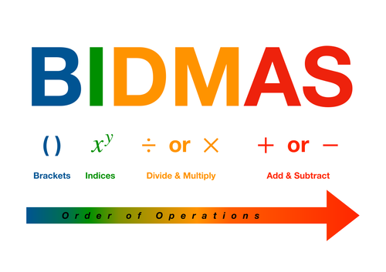
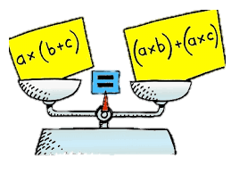
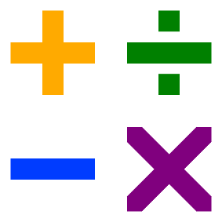
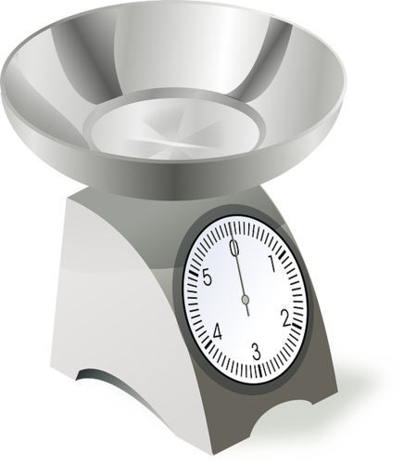
Higher Education
Mathematical Studies (Enrichment course)
Optional
Our Maths Learning Journey
13
Mathematical Studies (Enrichment course)
Optional
Employment
A Level Further Maths
Pure – 75% (independent to regular Maths, running in parallel)
Applied – 25% (Decision, logic)
A Level Maths
Pure – two thirds (Algebra, trigonometry, calculus)
Applied – one third (Stats & Mechanics
A Level Further Maths
Pure – 75% (independent to regular Maths, running in parallel)
Applied – 25% (Decision, logic)
12
A Level Maths
Pure – two thirds (Algebra, trigonometry, calculus)
Applied – one third (Stats & Mechanics)
Foundation GCSE Content
Indices, Fractions, Algebra, Standard Form, Congruence, Similarity and Vectors. Then revision, revision, revision!
Higher GCSE Content
Vectors, Geometric Proof, Proportion, Graphs, More Trigonometry, Further Statistics. Then revision, revision, revision!
11
Higher GCSE Content
Angles, Trigonometry, Algebra, Area, Volume, Transformations, Constructions, Equations, Inequalities, Similarity, Congruence, Circle Theorems.
Foundation GCSE
Graphs, Transformations, Ratio & Proportion, Pythagoras, Trigonometry, Probability, Multiplicative Reasoning, Perimeter, Area, Volume, Quadratics, Constructions, Loci and Bearings.
Angles
Angles in parallel lines, angles in triangles and problem solving using exterior and interior angles.
Fractions and Percentages
All the functions with fractions. Calculating percentages with and without calculators.
10
Equations, Inequalities & Sequences
Solving equations including brackets and variables on both sides. Inequalities and finding the nth term of a sequence.
Averages & Range
Types of average, estimating the mean and sampling.
Algebra
Simplifying, substituting, using expressions and formulae, expanding and factorising.
Graphs, Tables & Charts
Representing data, pie charts, scatter diagrams, time series, two way tables and lines of best fit.
Angles and Shape
Alternate angles and proof. Exterior & Interior angles. Solving geometric problems.
Expressions and Equations
Expanding & Factorising, solving one and two step equations.
9
Number
Calculations, decimals, index notation, factors & multiples, prime factorisation, squares, cubes & roots.
Straight Line Graphs
Direct proportion on graphs, gradients, equations of straight lines.
Decimals & Ratio
Ordering, rounding decimals. Place value calculations. Ratio and proportion with decimals.
Angles
Calculating angles in triangles and Quadrilaterals
Real life Graphs
Conversion, Distance-Time and curved graphs
Sequences
Inc. Patterns and straight line graphs
Number
Powers, Roots and divisibility
8
Probability
The language and calculating probabilities
Ratio
Proportion with fractions and percentages
Statistics
Pie charts, tables, stem & leaf diagrams, scatter diagrams and misleading graphs.
Transformations
Reflections, rotations, enlargements and translations
Area & Volume
Area of triangles and quadrilaterals. Volumes and surface area of prisms.
Fractions & Percentages
Converting fluently between fractions, decimals and percentages
7
Decimals & Measure
Rounding decimals, length, mass, capcity, scales, perimeter & area
Algebraic Skills
Writing expressions, simplifying and substituting into formulae
Number Skills
BIDMAS, Money, Time, Negative Numbers
Analysing and Displaying Data
Averages, Graphs
Welcome to Maths!

