Slide 1

Performing Arts BTEC

Slide 2

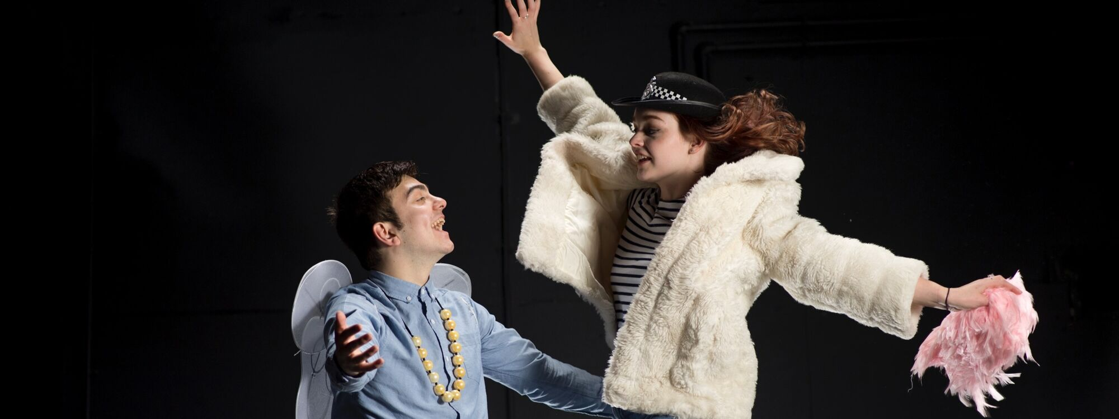
Unit 1 - Investigating Practitioners’ Work
The main goal of Unit 1 is for learners to investigate the work of various performing arts practitioners (e.g., directors, choreographers, theatre companies, etc.) and develop a critical and contextual understanding of how these professionals communicate themes and ideas in their work. This includes understanding the historical, social, and cultural factors that influenced the practitioners and their work.
Key Learning Outcomes
Assessment Methods
Question 1: Focuses on contextual factors and how they influenced the chosen practitioner and their work (e.g., economic, political, social factors).
Question 2: Assesses how performance and production elements were used to communicate a specific theme.
Question 3: Requires learners to compare and contrast the work of two different practitioners in response to a given theme or stimulus.
Develop skills in researching and collating information from primary and secondary sources.
Gain knowledge of various employment opportunities and career pathways within the performing arts sector.
Enhance their critical analysis skills to evaluate performances and production choices.
Understand the business and financial management aspects of the performing arts industry, such as budgeting and funding.

Slide 3

Unit 2 - Developing Skills and Techniques for Live Performance
What you'll learn: You'll gain practical skills in body movement, vocal control, and creative interpretation—tools essential for any performer. This includes training in at least two different performance styles (e.g., classical and contemporary theatre, ballet and modern dance).
How you'll learn: Through regular workshops, classes, and practical exercises, you’ll build technical and performance skills. You’ll also have opportunities to perform live, which will help you learn how to engage an audience and refine your craft.
Why it's valuable: The skills you develop will prepare you for further study or training, and they’ll give you a solid foundation for a career in the performing arts industry. Whether you want to act, dance, or perform in musical theatre, this unit will help you grow and become more versatile as a performer.
If you’re passionate about live performance and want to improve your skills, this subject will give you the experience and knowledge needed to succeed in the arts.

Slide 4
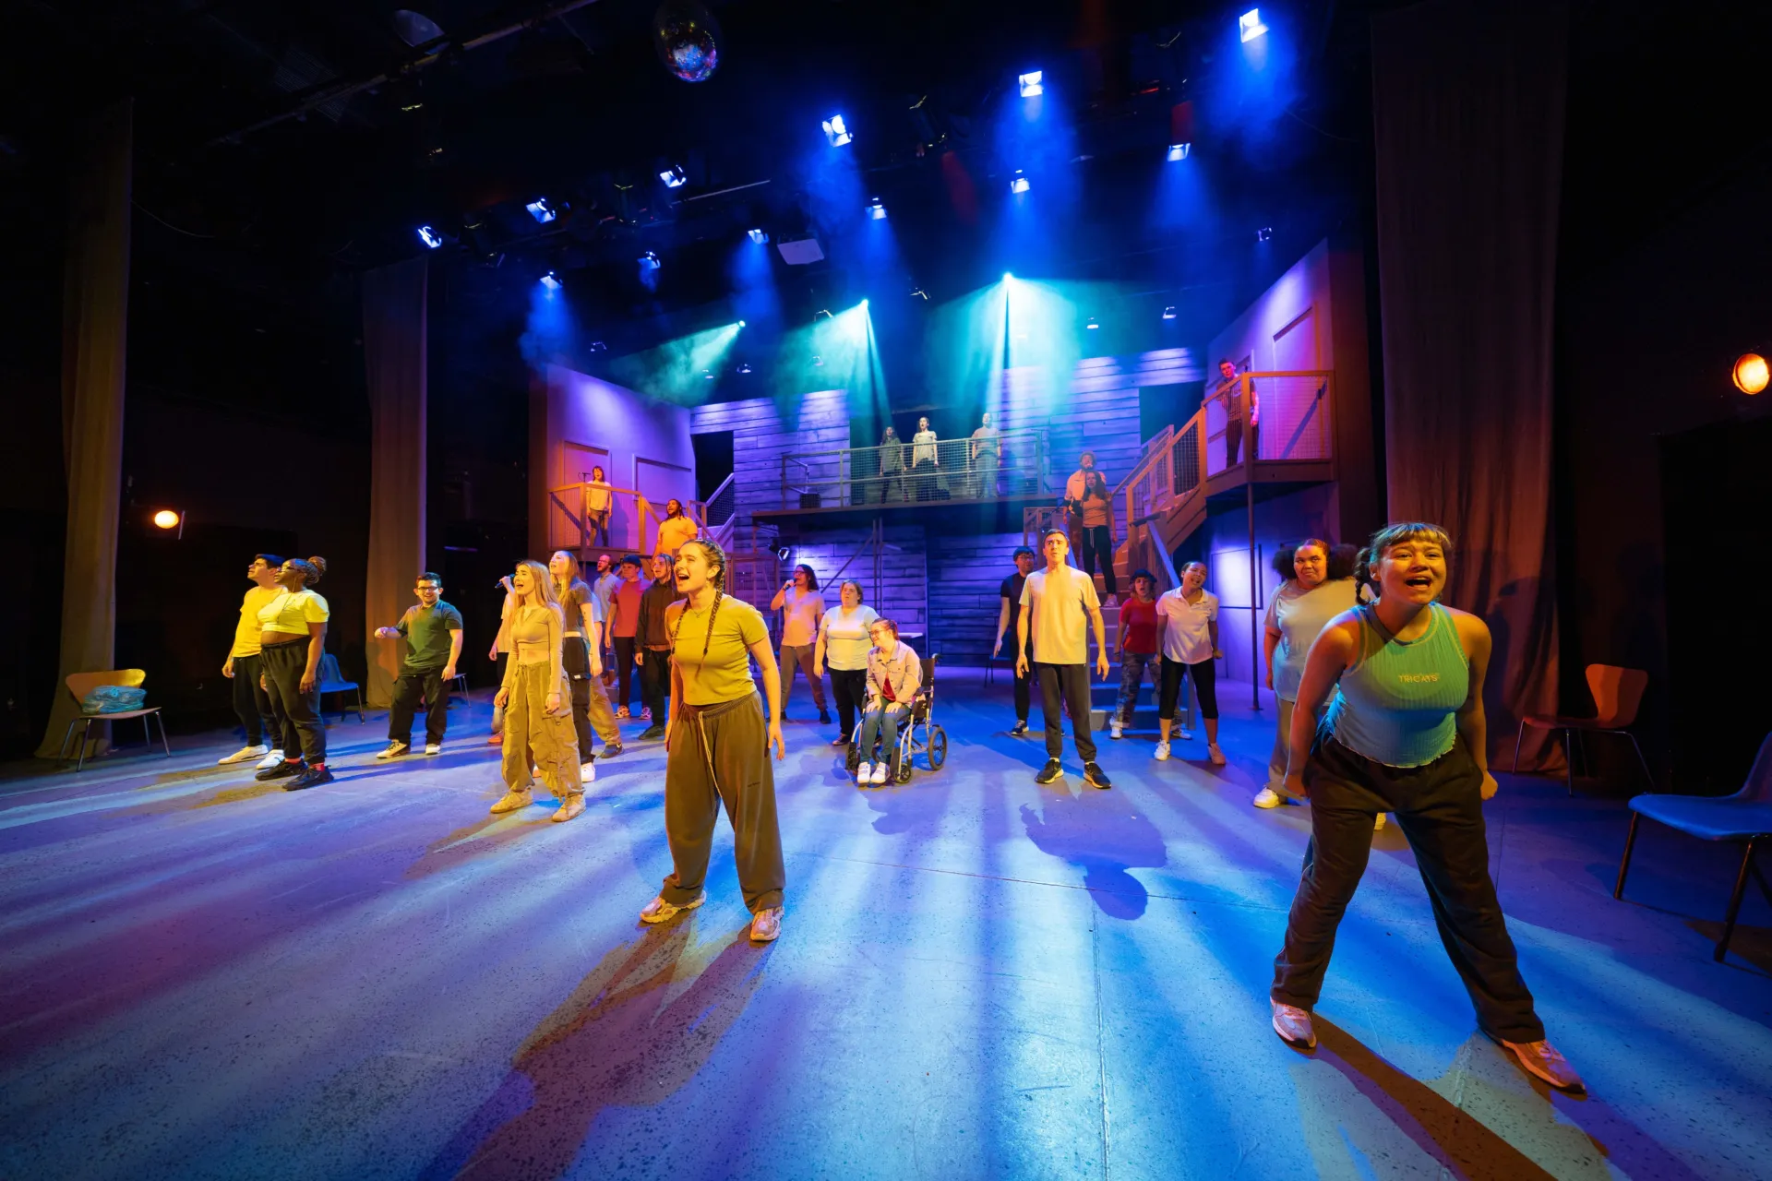
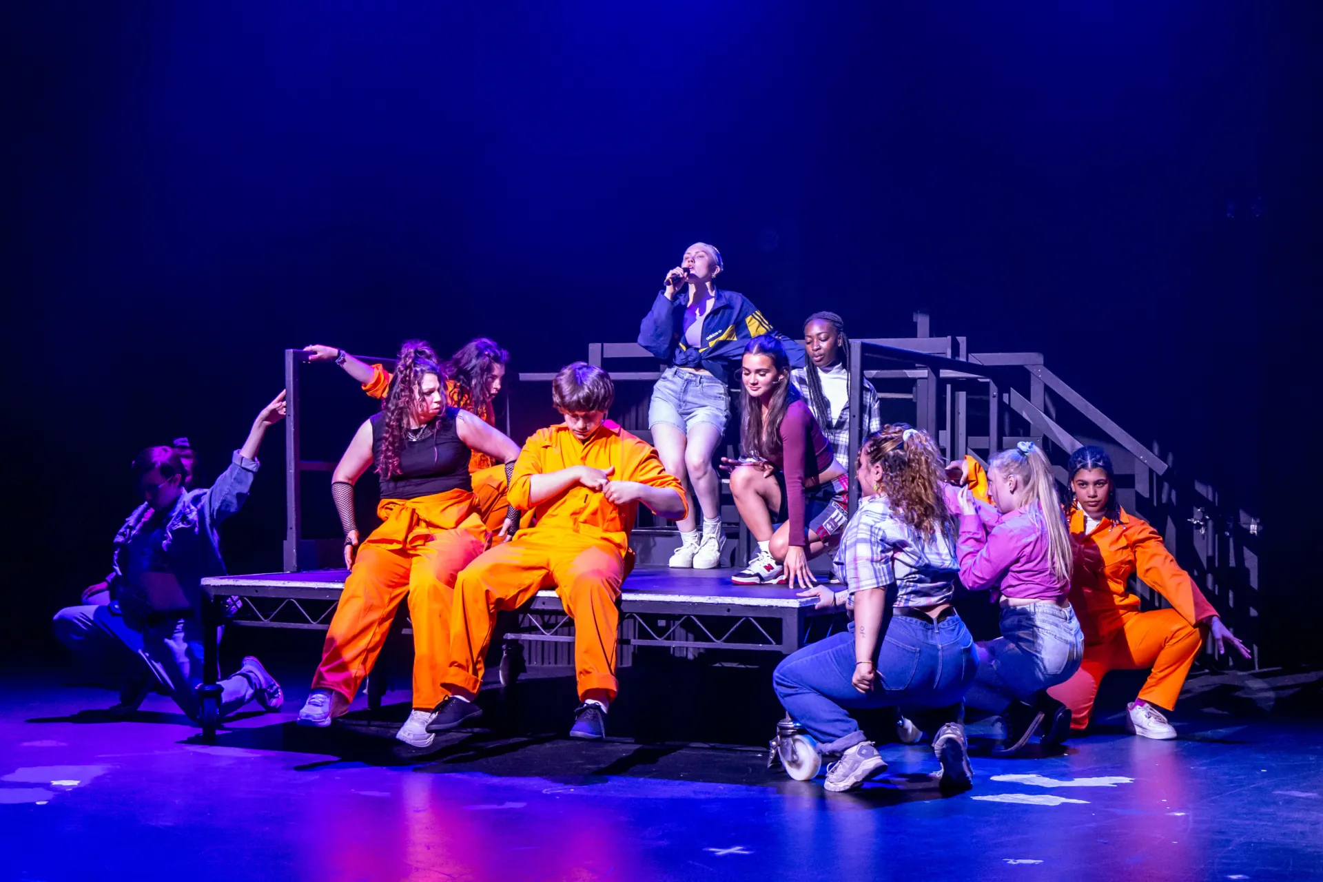
Unit 3 - Group Performance Workshop
In this unit, learners work collaboratively to create and perform a piece of original theatre in response to a given stimulus
Key Activities
Learners engage in a process that mirrors professional practice in the performing arts industry:
Interpretation of Stimulus: Students understand how to interpret and respond to a given theme, text, image, or aural material for a group performance.
Development of Creative Ideas: They explore and generate original ideas, applying different forms, elements, and techniques. This involves a rehearsal process to practice and refine skills, giving and taking direction, and collaborating as a team.
Performance Workshop: Students apply their performance skills (use of body, voice, communication with audience and peers) in a live, unedited, continuous group performance for an audience.
Assessment Evidence
The assessment typically requires the submission of specific evidence:
A Digital Process Log: A written log (up to 800 words per milestone) detailing the planning, development, and review stages of the work.
A Digital Video Recording: An unedited video of the final group performance to an audience, typically between 10-15 minutes long
Review and Reflection: Learners critically analyse and evaluate the effectiveness of their working process and the final workshop performance

Slide 5
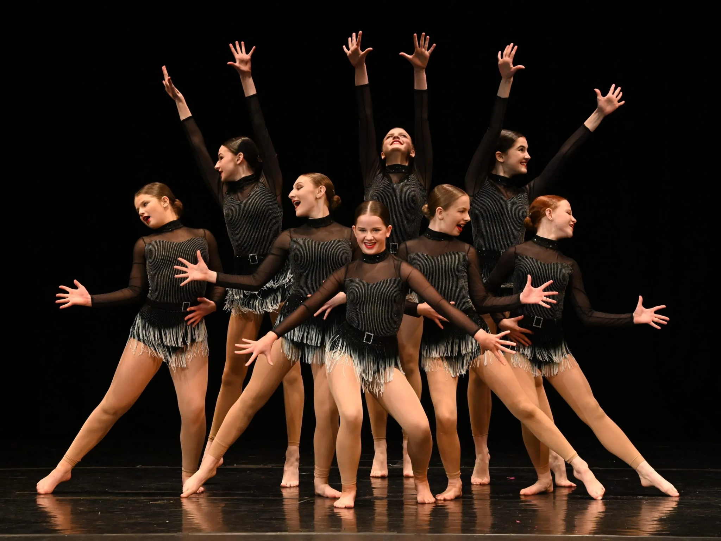
Unit 10 - Jazz Dance Technique
Will involve:
Practical training in jazz dance style and theory
Focus on technical skills, performance, and creating original work.
Learn historical context, develop choreography skills, and gain experience in professional practice
Often taught alongside other dance and theatre styles like Contemporary, Hip Hop, or Musical Theatre.
The curriculum prepares students for progression into higher education or careers in the performing arts industry.

Slide 6

Unit 19: Acting Styles
What You Will Learn:
Different acting styles and techniques (e.g., naturalism, comedy, Greek theatre)
How to analyze practitioner methods and apply them in performance
How to develop and reflect on your acting skills
What You Will Learn:
Different acting styles and techniques (e.g., naturalism, comedy, Greek theatre)
How to analyze practitioner methods and apply them in performance
How to develop and reflect on your acting skills
Why It’s Valuable:
Builds versatility and adaptability as an actor
Enhances performance skills for auditions and productions
Prepares you for further study or a career in drama and theatre

Slide 7
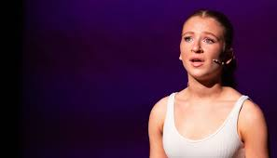
Unit 20 - developing the voice for performance
Criteria and summary of unit:
Learning aim | Key content areas | Recommended assessment approach
A Explore the principles of voice production | A1 Investigate the principles of voice production | A report or presentation demonstrating knowledge and understanding of the key principles of voice production, with reference to the body, breath, sound and articulation.
Develop vocal techniques for a performance | B1 Developing vocal exercises B2 Developing vocal warm-up B3 Vocal techniques, selected texts and performance spaces | A recorded performance (4–10 minutes) demonstrating the use of vocal techniques for a selected performance. Log with records of vocal exercises and plan for vocal warm-up. Analysis of selected vocal techniques. Recorded footage (development and application of techniques): • voice sessions • rehearsals. Observation records.
C Apply vocal techniques to a performance | C1 Apply vocal techniques in rehearsal C2 Apply vocal techniques in performance | A performance log that reviews and evaluates the development and application of vocal techniques for a performance, with reference to knowledge developed from learning aim A, presented using relevant techniques, for example digital, recorded.
Review personal development and own performance | D1 Review and evaluate development of vocal techniques D2 Review and evaluate application of vocal techniques
Skills you’ll learn - Learners develop their vocal techniques and improve their vocal skills in order to realise the power of the spoken word in performance.

